Slide 1
ENOVIA V6 Architecture
Architecture, File Synchronization, Secure Access, and Global Collaboration
Notes:
1
- Architecture
Overview level first then more detailed
o Logical & Physical Architecture (Solution Structure Overview)
§ Components
· Their role
· Their relationship with other components
· AS, FCS, DBS, Load Balancing, Licensing, other servers
· Protocols being used
§ Criteria to be considered when Building/Choosing an architecture
· Qualities
o Availability
o Maintainability
o Evolutivity
· Constraints
o LAN Architecture / WAN architecture
§ Impact of Latency / Throughput / WAN accelerator
§ Cache
o Storage architecture
o High availability
o Disaster recovery
o Backup / restore
o Performance and Architecture Capacity Scalability
o Resources virtualization
§ Partitioning
§ VIO
§ VLAN
§ VMWARE
o Resources provisioning
o
o Production Environments
§ Prod, Pre Prod, Dev, Industrialisation, Training, Maintenance ?
§ Mechanisms to move from one env. to another

Slide 2
Learning Objectives
At the end of this module, you should be able to:
Describe the ENOVIA V6 Architecture and its major components
Describe how ENOVIA V6 addresses remote user file access
Describe the secure infrastructure provided by ENOVIA V6
Describe how ENOVIA V6 addresses global collaboration

Slide 3
Agenda
1
V6 Architecture Introduction
2
Multi-Site and Content Synchronization
3
Internet Security and Remote Access
4
Web Conferencing and Global Collaboration
Notes:
3

Slide 4
Agenda
1
V6 Architecture Introduction
2
Multi-Site and Content Synchronization
3
Internet Security and Remote Access
4
Web Conferencing and Global Collaboration
Notes:
4

Slide 5
ENOVIA V6 Architecture Value Proposition
Improve operational efficiency
New architecture for centralized data center
“Single source of truth”
Modularized open architecture
Accelerate time to market
Secure global collaboration
Integrated design chain
End-to-end product lifecycle management
Decrease costs
Horizontal scalability
Future-proof growth
Centralized administration

Slide 6
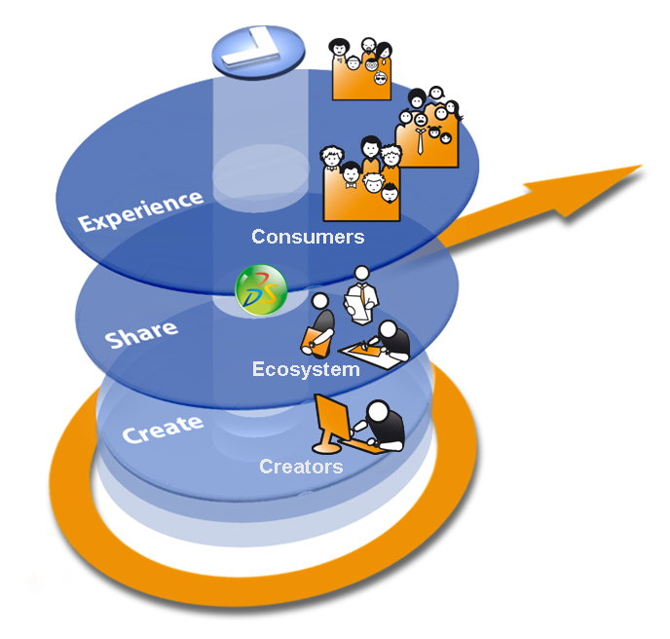
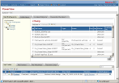
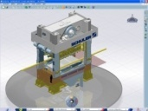






V6 Multi-Tier Architecture Principle
Web Clients Ex.: ENOVIA business process applications
Presentation
Light Visualization Clients Ex.: ENOVIA 3DLive
Workstation Clients Ex.: CATIA V6, DELMIA V6, SIMULIA V6, xCAD…
Clients
HTTP
A
Logic
Applications Server(s) (MCS)
Index Servers * Indexing Repository
S
F
File Server(s) (FCS) Representation and Content Repository
Data
D
(*) Optional.
Database Server: Metadata Repository
Notes:
Data Tier
- Database Server Role: Storage of meta data i.e. “data about data”.
- Search Server
Role: Index meta data and files for key word searching and refinement.
- File Server called in ENOVIA “File Collaboration Server” or FCS / STORE
Role: Rapid storage and retrieval of representations (like CAD geometry for instance).
Physical view: Application Server + File server w/ FCS applications installed – the application server being limited to transfer files for the file server to the client seat.
Logic Tier
- Application Server called in ENOVIA “Main Collaboration Server” or (MCS) / RDBMS
Role: Handle the business logic and data access of the applications.
Physical view: Application Server w/ MCS applications installed
- Web Server(s) Role: Accept HTTP requests from web clients and serve them HTTP responses along with optional static contents (web pages, style sheets, java scripts, etc.).
Can be also used as a proxy/load balancing server.

Slide 7

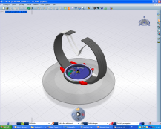

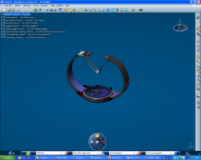
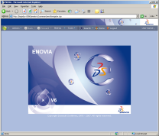
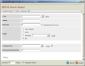
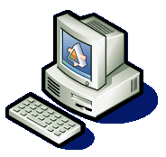



Multi-Client Topology
3DLIVE.. V6
HTTP
CATIA V6
V6 Governance Applications
D
A
CATIA V5
F
SIMULIA V6
xCAD
DELMIA V6
Notes:
7

Slide 8

V6 Centralized Database Architecture
One Location
D
A
F
A: ENOVIA Application Server (MCS)
D: Database Server (DB)
F: ENOVIA File Server (FCS)
Reduces Total Cost of Ownership (TCO)
Reduces Efforts to Create and Propagate Customizations & Upgrades
Optimized for WAN access for remote users
Notes:
8
Detailed TCO with maintenance
Minimum servers in master data center are: ENOVIA V6 Application Server; Database Server; ENOVIA V6 File Server
Recommended Proximity between ENOVIA V6 Application Server and Database Server
Architecture optimized for local and remote access
A unique source of truth: all the metadata related to product design are located on the master site
This is a simple central architecture. The database, web application, and file servers are all on machines located at a central data center. The architecture shown would utilize the file collaboration server, FCS, from ENOVIA for faster file distribution of content to the client. The FCS eliminates the file from having to make multiple “hops” between architecture components. Because Web clients are used there is no SQL*NET traffic across the WAN. However, the central file stores can be a problem if large file sizes must be sent from/to the Web clients. Therefore, this architecture is only used when most design activity is local, and the distributed users can be considered consumers (or viewers) of the design data (manufacturing, marketing, purchasing, etc.).

Slide 9







V6 IT Infrastructure Components – NEW!
Master Collaboration Server (MCS) - Business Logic and Web Access
Advantages:
Single Database for “one source of truth” isolated from direct user interaction
Cost-reduction via enablement of component architecture
Modular architecture designed for future growth
File Collaboration Server (FCS) - Content and Stream Storage Data
Database Server (DB) - Metadata Storage Data
Required
3D Indexing Server (3D INDEX) - Accelerated Retrieval of 3D Data
Optional
Advanced Search Server (IDOL) - Accelerated Retrieval of Textual Data
Conferencing Server (CNF) - Real-Time Lifelike Collaboration
…
Note: Initials (MCS, CNF, etc) will be used as short names on the following slides.
Notes:
This is a list of the typical servers deployed in a data center for ENOVIA V6. They are quite different from what VPM V4 or V5 customers have previously known. The major server types will be discussed in the following slides.

Slide 10

Master Collaboration Server (MCS)
Application Server for business objects
Primary server used by ENOVIA clients
Can be fronted with an HTTP server for static content
ENOVIA V6 code runs inside standard J2EE containers such as IBM WebSphere and Tomcat
Can be clustered by via load-balancers
ONLY the MCS has a direct connection to the database for metadata
BENEFITS:
Protection of data layer from direct client connections
Horizontal scalability
OS
HTTP Server
Application Server
ENOVIA V6
MCS Code
Notes:
This is the classic front-end server of a typical 3-tier architecture. There is a web server and a J2EE Application server which provides:
1/ Business logic
2/ Connection to the database (exclusively from the C++ code embedded via JNI in the J2EE container)
3/ GUI builds and transmission to users
Clustering can be achieved via WebSphere ND or via a hardware load-balancer such as the Cisco CSS or a BigIP F5

Slide 11

File Collaboration Server (FCS)
Content Storage for PLM-related Documents – generally attached to external storage
Can be used for placing content closer to users via synchronization
Can be clustered
All access is controlled by ENOVIA security policy
Filenames are not humanly readable and there is no direct file system access for clients
BENEFITS:
Consolidate all PLM-related documents into “one source of truth”
LAN and WAN performance improvements
OS
HTTP Server
Application Server
ENOVIA V6
FCS Code
Content
Notes:
The FCS (File Collaboration Server) is the central storage point for all non-metadata, ie, CATIA files, Word documents, Powerpoint presentations, Excel spreadsheets, PDF documents, etc.
The FCS can be deployed remotely to get the content closer to remote users via content replication.
Clustering can be achieved via WebSphere ND or via a hardware load-balancer such as the Cisco CSS or a BigIP F5

Slide 12

Database Server (DB)
Central storage for all metadata
Database files should be stored on external storage bay
High-performance 64-bit databases
Only directly accessed by the MCS
Connects via native protocols from the MCS process
BENEFITS:
Structured data storage for metadata
Manage huge volumes of information
Increased data security by using industry standard databases (Oracle, DB2, etc.) and storage technology
OS
Database Instance
Database Client / Listener
RDBMS Server
Data Files
Notes:
The Database Server runs a relational database such as DB2, Oracle 10g, SQLServer 2005 or MySQL.
It should be connected to its storage bay via a 2Gbit FC link or iSCSI with high-bandwidth and very low latency.
The LAN connection to the Web/App server should be 1Gbit minimum.
Note again that clients NEVER connect to the database directly.
Use banks as example for uses of large databases…

Slide 13
Advanced Search Server (IDOL)
Used for enabling full-text searches through content and metadata (called Advanced Search in ENOVIA)
Indexes can stored on external storage
Based on the Autonomy IDOL 3rd party application
Must be distributed using FSF processes on all FCS machines
BENEFITS:
Accelerated access to IP captured in both metadata and all textual supports
Collection and storage of all local and remote content into one cohesive index
OS
DiSH Process – License Server
File Fetcher Service (FSF)
IDOL Index Server
Indexes
Notes:
The index server uses 3rd party software. It enables full-text searching through all PLM-related content

Slide 14

3D Index Server (3D INDEX)
Used for enabling 3D Searching through PLM data
Indexes can be stored on external storage
The Build and Runtime environments can be on separate machines for production
Critical NEW functionality and innovation for ENOVIA V6 structure navigation
BENEFITS:
Increase of overall intellectual property due to innovative computations on metadata and geometry
Accelerated retrieval of 3D data
OS
SDAM Process
CATplm Index Servers
PLM Index Admin Tool
3D Indexes
Notes:
The index server uses 3rd party software. It enables full-text searching through all 3D data volume searches.

Slide 15

Conferencing Server (CNF)
Used for conferencing and global design collaboration
Enables 1 to many collaboration on a LAN
Enables co-review and co-design on a WAN
Can be used with Lotus Sametime or Microsoft Office Communicator
BENEFITS:
Enables global innovation and collaboration
Can include exchanges over audio, video, etc.
OS
Web Server
Directory Server
Collaboration Tool
LDAP Directory
Notes:
The Collaboration server allows for real-time collaboration on designs with remote users.

Slide 16
Other Servers and Equipment
Batch, queue manager, or grid controller for background jobs
DSLS (OEM of LUM V5) Licensing servers
Report server for Crystal Reports for data mining in PLM database
Others depending on optional offerings such as ERP integration
SSL VPN Server for certificate management and authentication of users coming in from the internet over a VPN
Reverse-Proxy Server for protecting the identity of the servers in the data center
Storage bay for all content (indexes, database, and content) with backup and restore procedures
Load-balancers for clustering servers

Slide 17


V6 Data Types – NEW!
PLM Metadata for objects and relationships as well as business logic
PLM Content including 3D representations, streams, office documents, etc. Note: No more file-based access!
PLM Indexes to accelerate access to data and geometry
Database Server
File Server
Index Servers
Metadata
Content
Indexes
3D Rep
3D Index
PLM Object A.1
PLM Object A.2
3D Stream
PLM Object B.1
PLM1.doc
Indexes
PLM2.pdf
Advanced Search Index
Notes:
17
PLM Objects as Metadata
Located in Database server
Unique repository of PLM information
Metadata only accessible via Master Collaboration Server
PLM Objects point directly to stream within Store Server
Long Data
Core PLM data
PLM representation as Streams
PLM representations = CGR, Nav Rep, Shape, ...
Index data
Optional 3D research capability for improved performance

Slide 18

V6 Application Server in Monolithic Configuration
V6 Application Server (MCS)
ENOVIA Components view
J2EE Container
ENOVIAStudio
ModelingPlatform
ENOVIA Live Collaboration Server (RIP)
C++
ENOVIA LiveCollaborationBusinessProcessServices(BPS)
…
ENOVIA Centrals - Optional
ENOVIA LiveCollaborationPlatformServerVPM(VPM)
Java
DB2Cli or SQL*Net
FTP/NFS
MCS
Metadata
Content
Notes:
18
18
This is a simple central architecture. The database, web application, and file servers are all on machines located at a central data center. The web server could be an Apache web server acting as a proxy/load balancing server, or it could be a load balancing router. The architecture shown would utilize the file collaboration server, FCS, from ENOVIA for faster file distribution of content to the client. The FCS eliminates the file from having to make multiple “hops” between architecture components. Because Web clients are used there is no SQL*NET traffic across the WAN. However, the central file stores can be a problem if large file sizes must be sent from/to the Web clients. Therefore, this architecture is only used when most design activity is local, and the distributed users can be considered consumers (or viewers) of the design data (manufacturing, marketing, purchasing, etc.).
Live Collaboration Server is the old RMI Server under MatrixOne (Remote Method Invocation)
Live Collaboration Server enables communication between the various Centrals.

Slide 19
V6 Application Server in Split Configuration
V6 Application Server (MCS)
ENOVIA Components view
V6 File Server (FCS)
ENOVIA Components view
FCS
J2EE Container
ENOVIAStudio
ModelingPlatform
HTTP/S
J2EE Container
ENOVIA Live Collaboration Server (RIP)
FCS can be implemented in standalone mode
Java
ENOVIALiveCollaborationBusinessProcessServices (BPS)
ENOVIA
Live Collaboration Server (RIP)
…
ENOVIACentrals - Optional
FTP/NFS
C++
C++
ENOVIALiveCollaborationPlatformServerVPM (VPM) - Optional for VPLM
Content
Java
DB2Cli or SQL*Net
MCS
For FCS:
Only ENOVIA Live Collaboration Server (RMI) is necessary
No Database connection
Metadata
Notes:
19
19
This is a simple central architecture. The database, web application, and file servers are all on machines located at a central data center. The web server could be an Apache web server acting as a proxy/load balancing server, or it could be a load balancing router. The architecture shown would utilize the file collaboration server, FCS, from ENOVIA for faster file distribution of content to the client. The FCS eliminates the file from having to make multiple “hops” between architecture components. Because Web clients are used there is no SQL*NET traffic across the WAN. However, the central file stores can be a problem if large file sizes must be sent from/to the Web clients. Therefore, this architecture is only used when most design activity is local, and the distributed users can be considered consumers (or viewers) of the design data (manufacturing, marketing, purchasing, etc.).
Live Collaboration Server is the old RMI Server under MatrixOne (Remote Method Invocation)
Live Collaboration Server enables communication between the various Centrals.

Slide 20
JVM Process Memory usagefor ENOVIA V6
Writing to disk if overflow: MX_FLASH_PATH environment variable
System memory limit error if overflow.
List of C++ objects
MX_MEMORY_SYSTEM_LIMIT
C++ (native) Kernel
FlashDB cache (copies of DB rows)
MX_CACHE_SYSTEM_LIMIT
To be sized according to the number of users (concurrent access)
Java Objects - Garbage Collector -
Xmx (Maximum size)
Java Heap
To be sized according to the number of managed objects (BOM sizes)
Xms (Allocated size)
Note: This is necessarily a 32-bit process and therefore the hard limit on –Xmx + MX_MEMORY_SYSTEM_LIMIT is 1.5 GB (Windows) or 2.2 GB (AIX)

Slide 21

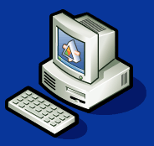

Logical Architecture for V6
3DLIVE
Navigator
Governance
CATIA/DELMIA/SIMULIA V6
IDOL
3D INDEX
MCS
FCS
Client-DB Proprietary protocol
Client-MCS http/s protocol
Client-FCS http/s protocol
Client-IDOL Runtime http/s protocol
Client-IDOL Buildtime http/s protocol
Client-3D Index Runtime http/s protocol
Client-3D Index Buildtime http protocol
DB

Slide 22
Logical Architecture for V6 / CATIA V5
CATIA V5/ Designer Central
3DLIVE
Navigator
Governance
IDOL
MCS
FCS
Client-IDOL http/s protocol
Client-MCS http/s protocol
Client-FCS http/s protocol
Client-DB Proprietary protocol
DB

Slide 23
Logical Architecture for Co-existence V6 / VPM V4
3DCOM
CATIA V5
3DLIVE
Navigator
Governance
CATIA/DELMIA/SIMULIA V6
Client-VPM CORBA protocol
VPM V4 VAULT
Client-MCS http/s protocol
VPM V4
IDOL
3D INDEX
MCS
FCS
Client-FCS http/s protocol
Client-DB Proprietary protocol
Client-IDOL Runtime http/s protocol
Client-IDOL Buildtime http/s protocol
Client-3D Index Runtime http/s protocol
Client-3D Index Buildtime http protocol
DB

Slide 24
Logical Architecture for Co-existence V6 / VPM V5
VPMNav/CATIA V5
3DLIVE
Navigator
Governance
CATIA/DELMIA/SIMULIA V6
Client-VPM CORBA protocol
VPM V5 VAULT
Client-MCS http/s protocol
VPM V5
IDOL
3D INDEX
MCS
FCS
Client-FCS http/s protocol
Client-DB Proprietary protocol
Client-IDOL Runtime http/s protocol
Client-IDOL Buildtime http/s protocol
Client-3D Index Runtime http/s protocol
Client-3D Index Buildtime http protocol
DB

Slide 25

ENOVIAV6 Flexibility
From demo environment to full-scale production prototype
Demo
Sandbox /
Training
ProofofConcept
ProductionPrototype
MCS + FCS +DB+NDX
MCS + FCS +DB Client +NDX
MCS +DB Client
FCS Server
IDOL Server
MCS +DB Client
FCS Server
DB Server
DB Server
3D Index Server
DB Server
Conferencing Server
Notes:
25
Different Technical infrastructure configurations to be defined according to customers requirements.
Examples of criteria:
number of users,
scalabilityrequirements,
performance requirements
System management requirements
project phase,
geographicalconstraints,
E.g: The minimal installation could be used as a development platform as well as for functional tests and education.
Typically at deployment each Server is associated to a separate physical machine or partition.
Also shown in this architecture is the ability to use multiple application servers for scalability. Each application server is configured to run in a “RMI-in-process”, or RIP, mode. This consolidates the application server and the ENOVIA kernel into the same JVM for the utmost performance. The web server could be used as a proxy/load-balancing server and also increases performance by delivering static web content. A hardware load-balancer could also be deployed. The number of application servers depends on the number of concurrent users and the capacity of the application server in terms of the number of CPUs and the maximum amount of RAM. This could also be a single physical machine running multiple server processes.

Slide 26

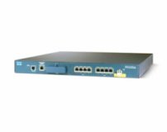
ENOVIA V6 Flexibility
MCS Load Balanced Cluster on LAN
Note that load balancer can
either be in software or
hardware and configured based on load or IP address as appropriate
Load-balancer
MCS
Load-balancer
Load-balancer
Conferencing Server
MCS
DB
FCS Server
3D Index Server
IDOL Server
MCS
FCS Server
3D Index Server
DBServer
Notes:
26

Slide 27



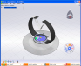

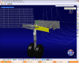


Load balancing and fail-over for MCS and FCS
http
http
http
Phase 2
Phase 2
Load Balancer
Hardware
Software
http
Phase 2
http
Load balancing:
Ability to dispatch load on different Application servers or File servers
Fail Over:
In case of failure of an application server:
Subsequent transactions is dispatched on another application server
No loss of service time for users connected to running machine
Notes:
27
Load Balancing provides Scalability and Availability of the Application Server
Load Balancing could be done by Hardware or Software Load Balancing
There are several possibilities, among them:
1 - Reverse Proxy acts as a Load Balancer → Websphere Edge Server. Application Server is WebSphere as
2 – HTTPServer + WebSphere ND (not supported)

Slide 28

Zoom inside MCS for Scalability
…
…
…
…
HTTP Server
Web App Server
Web App Server
Web App Server
ENOVIA Java Process
ENOVIA Java Process
ENOVIA Java Process
…
Horizontal Clustering
In-box Clustering
Note: no direct 1:1 linear correlation between number of users and number of DB connections

Slide 29





Batch Jobs
MCS
http
“local”
FCS
Submission modes:
Interactive (CATUTIL)
CAA API
Command line
Submission modes:
CAA APIs depending on GRID
Command line
Based on Microsoft Compute Cluster Service 2003 (CCS)
NOTE: Additional Hardware could be deployed on remote sites for batch management – shown here as the “Remote” Batch Server generally running MQseries
DB
V6 Backbone (tcp)
MQ (http)
MCS
http
“Submitter”
FCS
“Remote”
Batch Server
DB
MCS
http
FCS
DB
“GRID”
Notes:
29

Slide 30


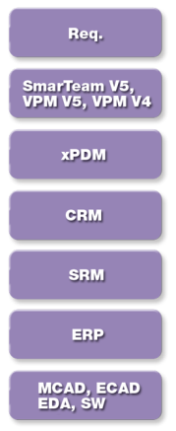
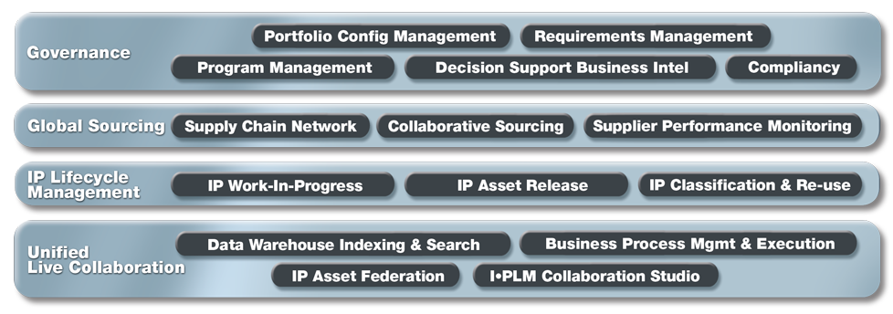


Two Platform Choices based on Modules…
VPM V6 Platform Support (Rich Client Support)
Collaborative Innovation
All Others: Governance
The platform choice for VPM V6 is more restrictive than the Governance modules. In the case of installing both Governance and VPM V6 modules, you must of course choose from the more restrictive platform choices of VPM V6
Notes:
30
30
Let’s zoom into the V6 Solution Referential:
At the modeling & simulation level we have CATIA for Virtual Design, SIMULIA for Virtual Testing & Compliancy & DELMIA for Virtual Manufacturing & Production.
ENOVIA is the fundamental component for Global Collaborative Innovation for PLM.
Four main domains:
Live Collaboration Platform
IP Lifecycle Management
Global Sourcing
Governance
Deliver integration with large number of applications and enterprise application

Slide 31
Platforms OS Middleware see program directory for definitiveplatform info!
Application Server Operating System
Windows Server 2003 32-bit/64-bit
Linux RHEL 5 64bit
AIX 5.3 64-bit
Solaris 10 (SPARC or AMD) 64-bit
App Servers
xBOM/Governance
IBM WebSphere6.1 32-bit IBM JVM
TOMCAT 6.0.16 32-bit Sun JVM
BEA WebLogic 10 32-bit
RDBMS
DB2 V9.1 (Windows Server/AIX)
Oracle 10.2.0.3 (All Platforms)
MS SQLServer2005
MySQL Enterprise (Linux)
Application Server Operating System
Windows Server 2003 64-bit
Linux RHEL 5 64-bit
AIX 5.3 64-bit
VPM
WebSphere 6.1 32-bit IBM JVM
TOMCAT 6.0.16 32-bit Sun JVM
App Servers
DB2 V9.1 (Windows Server/AIX)
Oracle 10.2.0.3 (All Platforms)
MS SQLServer2005
RDBMS

Slide 32
Best Practices
It is highly recommended to deploy at least a pre-production environment alongside the production environment. This will greatly aid for:
Problem resolution without impacting production
Testing patches and upgrades before GoLive and production deployment
Hard failover environment in case of hardware failure of production equipment
The pre-production environment should be a clone in terms of software configuration and operating system as the production system
Depending on the high-availability requirements of the customer, the pre-production environment can be scaled down – as long as all the processes can start with NO CHANGES to the configuration files to keep the machine as a clone.
For the failover aspect (even a manual failover) to work, the two environments should be connected to the same storage area
Other additional environments commonly deployed include: Quality&Assurance, Training, and Development

Slide 33
Best Practices
Do NOT underestimate the importance of storage and backup/restore in a PLM deployment
Fast and redundant disk arrays will greatly increase the performance and security of the overall system
It is recommended to have at least 2 Gbit connection between the DB and the storage area
SAN is the preferred solution for storage
If a NAS is required, care must be taken in the implementation of NFS to assure good performance of the database
It is recommended to have at least 1Gbit switched or direct network connection between the MCS and the DB
Backup and restore procedures will need to be created during the pilot phase depending on the implementation and tools chosen by the customer –NOTE: these procedures should be tested and documented by the implementation team thoroughly before Go Live.
All data (database, indexes, content) should be stored on the storage bay to allow for centralized backups and fast recovery in case of failure as well as failover
Notes:
Virtual Ethernet on AIX can improve the performance between the two partitions

Slide 34
Agenda
1
V6 Architecture Introduction
2
Multi-Site and Content Synchronization
3
Internet Security and Remote Access
4
Web Conferencing and Global Collaboration
Notes:
34

Slide 35

V6 Centralized Architecture with Distributed Stores
F
D
A
F
F
A: ENOVIA Application Server (MCS)
D: Database Server (DB)
F: ENOVIA File Server (FCS)
F
Optimizes Performance by Eliminating Interactive File Transfers Across WAN by Storing Content Closer to the Remote Users on File Collaboration Servers (FCS)
File transfer done via Synchonization Jobs
Notes:
35
35

Slide 36
File storage concepts
File storage management is based on ENOVIA Live Collaboration Server mechanisms
The different concepts are:
STORE : MCS metadata stored in the databasedescribing :
The physical LOCATION of the various files
the association of users with their sites
LOCATION = physical location of the data. On an FCS, it is the path to the filesystem where the files/streams are stored.
SITE = geographical location of a user or group of users. LOCATION can be dedicated to SITE
FCS = File server for the master site and/or the remote sites
All of these are described by metadata stored in the database
A user is assigned to one SITE
A STORE can have several LOCATIONs
A SITE can have several LOCATIONs
For any particular unique version of content, there is one unique mapping of USER → SITE → STORE → LOCATION and this mapping is stored in the database
Notes:
36

Slide 37
Related Metadata
Database Objects
LOCATION
LOCATION1 = hostA:port:/xxx/yyy LOCATION2 = hostB:port:/zzz/vvv
STORE
STORE1.Default Location = LOCATION1 STORE1.Available Locations = LOCATION1, LOCATION2
USER
USER1.Site = SITE1 USER1.PreferedLocation=LOCATION1 USER2.Site = SITE2 USER2.PreferredLocation=LOCATION2
SITE SITE1 : LOCATION1,… SITE2 : LOCATION2,…

Slide 38
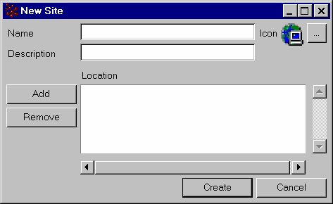
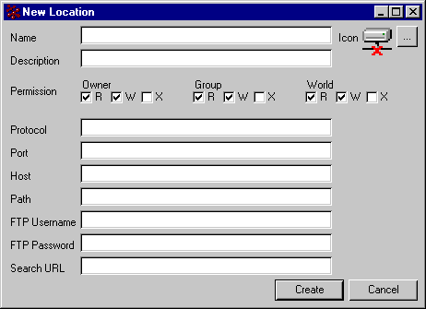
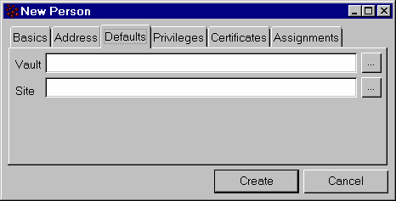
System Application

Slide 39


File storage mechanism
Business Environment
System Environment
Document_User1
STORE
Type
CAD
STORE_CAD
STORE_VPM
Name
Revision
State
Location 1
Location 3
Life Cycle
Name : Remote_Loc
Path : <Client_Destination>\Location
URL : http://<FCS_HOST>:<PORT>/ematrix
LOCATION
Location 4
Location 2
User_Designer
Name
John
SITE
SITE_Ryan
SITE_Munich
Master Collaboration Server
SITE = RYAN
FCS
FCS_HOST
User = John
<Client_Destination>\Location

Slide 40
File storage mechanism
Business Environment
System Environment
Document_User1
STORE
Type
CAD
STORE_CAD
STORE_VPM
Name
Revision
State
Location 1
Location 3
Life Cycle
Name : Remote_Loc
Path : <Client_Destination>\Location
URL : http://<FCS_HOST>:<PORT>/ematrix
LOCATION
Location 4
Location 2
User_Designer
Name
John
SITE
SITE_Ryan
SITE_Munich
Master Collaboration Server
SITE = RYAN
FCS
FCS_HOST
User = John
<Client_Destination>\Location

Slide 41
3 Scenarios
FCS 1 (LOCATION 1)
Capacity
(STORE A)
FCS 2 (LOCATION 2)
Site 1
FCS 1 (LOCATION 1)
(STORE A)
Distribution
Site 2
FCS 2 (LOCATION 2)
(STORE A)
FCS 1 (LOCATION 1)
(STORE A)
Multi-Store
FCS 2 (LOCATION 2)
(STORE B)

Slide 42



Synchronizations on demand
File information
About LOCATION is saved in DB
Step1:
file1 on LOCATION1
Step3:
file1 on LOCATION1
file1 on LOCATION3
Step1 . file1 ( ) on LOCATION1
Step2 . User on LOCATION3 requests file1
Step3 . The system synchronizes file1 on LOCATION3
SITE 1
MCS
Optional Behavior
FCS
FCS
LOCATION1
Default Behavior
SITE 2
SITE 3
FCS
FCS
LOCATION2
LOCATION3
Notes:
42

Slide 43


Synchronizations by command
Synchronization commands in Interactive
MQL: “Sync store plmx from location LOCATIONx to store;”
MQL: “Sync store plmx from location LOCATION1 to LOCATION3;”
and Schedule modes
every n minutes
everydayat 6:00pm
every 200 Mo to synchronize
MCS
DB
Optional Behavior
MASTER
FCS
SITE 1
FCS
LOCATION1
Default Behavior
SITE 3
SITE 2
FCS
FCS
LOCATION2
LOCATION3
Notes:
43

Slide 44
Scheduled synchronization
Types of synchronization
On Demand (for small flow of data)
By command
Scheduled (for large iterations)
Every N minutes
Everydayat6 pm
Every 200 MB to synchronize
Scheduledsynchronization to build the Best So Far version of a model for 3D Index and for a complete Backup
Define the time when all sites are in "lowactivity" (night, earlymorning) regarding time zone differences
Limitbandwithoverload for local sites
Ex. Need all associated data to create the 3D Index files
Ex. Need to collect all FCS data to Master for full backup

Slide 45
Multi Store
ENOVIA V6 Multi Store enables to use several stores to save documents or files.
Choosing the right Store:
The store assignment obeys customer-defined rules.
During the save or update of any document in ENOVIA V6 Server, store choice mechanism is executed to define a store for each document
Business Object Policy for xBOM/Governance Objects
Store is defined at the Business Object level
PLM Entity for VPM objects
Rules for store affectation are defined in a configuration file: PLMPolicyChooser.xml, on server side.
Those rules will allow the choice of a store according to:
User’s project,
User’s Organization
type of the PLM Entity

Slide 46
Agenda
1
V6 Architecture Introduction
2
Multi-Site and Content Synchronization
3
Internet Security and Remote Access
4
Web Conferencing and Global Collaboration
Notes:
46

Slide 47
Security Technology
LDAP
Common Authentication & Administration
Single Sign on
Authentication Shared by All Applications
SSL
Secure Socket Layer Packet Transport
HTTPS
Secure HTTP Web Transport over SSL
Digital Certificates
X509 Certificates for Identity Management
Security rules easily modeled with PLM Modeling Studio functionality
All data events stored in object history records
All system access stored in log files
Notes:
Security Integration
LDAP support enables our customers to standardize on a common authentication and user administration mechanism across enterprise applications. Not only can ENOVIA be configured to directly refer to standard LDAP servers, but it will automatically mirror user administration within the business model.
Single Login means that session and authentication is shared by all of our applications.
SSL and HTTPS support provide secure transport of web application interfaces and content.
Managed X509 Digital Certificate ensure recognition and security for trusted collaboration partners.

Slide 48






Authentication
P&O
Metadata
USERS
authentication
Information
1
http
http
http
MCS
RDBMS
2
FCS
LDAP
USERS
Authentication
Information
Collaboration Server
third party
LDAP Directory Server
third party
User authentication management
Option 1 - Default mechanism
User information (authentication & ACL data) are defined in the P&O tables in database
Option 2 - Users externalization
User information is stored in an LDAP directory and not in the P&O tables
The server performs the authentication through LDAP
P&O tables contain all ACL data
Notes:
48
There are two options for storing data related to user login:
1/ Default is to store all information in the P&O tables of the database – this includes both authentication and ACL data (access control lists)
2/ Authentication can alternatively be done against an LDAP server (ITDS, OpenLDAP, etc). The ACL data is still stored in the P&O tables of the database

Slide 49





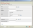

Authentication | Single Sign On
1
http
MCS
RDBMS
http
2
FCS
http
Collaboration Server
LDAP Directory Server
CAA client APIs to connect
to SSO mechanism
third party
third party
Single Sign On
One unique login for all applications
Governance: Plug-and-play into existing Single Sign-On infrastructure (such as Tivoli Identity Manager and SiteMinder)
CATIA V6: On the client, CAA APIs manage SSO credentials: “User Exit” must retrieve and provide credentials to the server login
Single Sign-on Server
third party
Notes:
49
Single sign-on infrastructures can be easily exploited by ENOVIA V6 The login data in the single sign-on dialog box is programmatically provided by the “User Exit” function in the CAA API

Slide 50
Authentication | Single Sign On for Web Client
1
http
MCS
RDBMS
http
2
FCS
http
Collaboration Server
LDAP Directory Server
third party
third party
Single Sign On
One unique login for all applications
Plug-and-play into existing Single Sign-On infrastructure (such as Tivoli Identity Manager and SiteMinder)
MCS connected to the Single Sign-on Server
Single Sign-on Server
third party
Notes:
50
Single sign-on infrastructures can be easily exploited by ENOVIA V6 The login data in the single sign-on dialog box is programmatically provided by the “User Exit” function in the CAA API

Slide 51


Multi Site Private network infrastructure
Firewall
Firewall
Firewall
1
VPN
RDBMS
MCS
2
HTTP / SSL / IPSEC
FCS
Collaboration Server
third party
DMZ
Remote Site Network
Public Network
OEM Network
Network security
Firewall management: Single port Access to V6 Server
NAT and name translation
Notes:
51
To be completed

Slide 52






Multi Site Public network infrastructure
Firewall
Firewall
Firewall
http /https
HTTP / SSL / IPSEC
RDBMS
http /https
http /https
http
MCS
Existing
Proxy
Reverse Proxy
FCS
third party
http /https
third party
http /https
User on Public Internet
Collaboration Server
DMZ
third party
Remote Site Network
Public Network
OEM Network
Network security
Firewall management: Single port access to V6 Server
NAT and name translation
HTTPS is supported from client to reverse proxy
Notes:
52
To be completed

Slide 53
Multi Site Data storage
Firewall
Firewall
Firewall
RDBMS
http /https
MCS
Proxy
Reverse Proxy
third party
third party
FCS
Local FCS
http/https File synchronization
DMZ
Collaboration Server
third party
Remote Site Network
Public Network
OEM Network
Notes:
53
To be completed

Slide 54

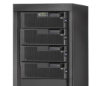



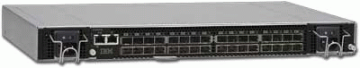
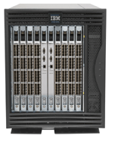
Secure Infrastructure – Central Data Center Data Center Example
Internet
DMZ
Application Layer
MCS
DB
FCS
NDX
CNF
Data Center
Fiber Switch
Data
Storage Bay / SAN
Orange = 1Gbit
Green= 2 Gbit FC or iSCSI
Dark Blue = Replication + GUI
Light Blue = GUI

Slide 55
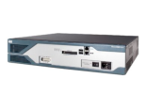
Secure Infrastructure - Internal Users - Example Local users accessing ENOVIA V6 via the Intranet
Internet
DMZ
Intranet
Firewalled Router
Local Users
Application Layer
MCS
Note: Intranet users may also connect via a web portal (like WebSphere Portal Server) and via other secure access methods.
As only http-based access is required by ENOVIA V6, the actual implementation will be customer-dependant
DB
FCS
NDX
CNF
Data Center
Fiber Switch
Data
Storage Bay / SAN
Orange = 1Gbit
Green= 2 Gbit FC or iSCSI
Dark Blue = Replication + GUI
Light Blue = GUI

Slide 56
Secure Infrastructure – Remote Sites - Example Remote sites over WAN or MPLS accessing ENOVIA V6 with local FCS
Internet
Note: Remote users may also connect via a web portal (like WebSphere Portal Server) and via other secure access methods.
As only http-based access is required by ENOVIA V6, the actual implementation will be customer-dependant
DMZ
Application Layer
MCS
Remote Site
DB
FCS
NDX
CNF
WAN
Proxy Server (Optional)
Data Center
Remote Users
Fiber Switch
FCS
Data
Storage Bay / SAN
Orange = 1Gbit
Green= 2 Gbit FC or iSCSI
Dark Blue = Replication + GUI
Light Blue = GUI

Slide 57
Agenda
1
V6 Architecture
2
Multi Site
3
Internet Security and Remote Access
4
Web Conferencing and Global Collaboration
Notes:
57

Slide 58

On-Line Conferencing Environment Functionalities
Collaboration modes
Client-Server : One to One, One to Many, Many to Many
Peer to peer (LAN Only V6 to V6)
Supported Middleware
IBM Lotus Domino, Lotus Sametime 7.5.1
Microsoft Live Communication Server : OCS 2007
Middleware architecture for conferencing is deployed as defined by IBM or Microsoft
V6 Instant collaborative capabilities:
3DLive : Co-review
Chat + 3DSnapshot + Co-review
CATIA V6 : Co-Review et Co-design
Share design in edit mode
Other capabilities supported :
Audio, video (3rd party-based only, based on Sametime or OCS2007)
Notes:
58

Slide 59






On-line Collaboration Environment Centralized Conferencing Server– Lotus Sametime
Firewall
Firewall
Firewall
RDBMS
MCS
Proxy
Reverse Proxy
third party
third party
FCS
http protocol
sip protocol
(Session Initiation Protocol)
Other third party protocol
(video, audio)
Sametime Gateway
third party
Sametime Server
DMZ
third party
Supplier / Partner
Network
Public Network
OEM Network
Notes:
59

Slide 60
On-line Collaboration Environment Distributed Conferencing Servers – Lotus Sametime
Firewall
Firewall
Firewall
RDBMS
MCS
Proxy
Reverse Proxy
third party
third party
FCS
sip protocol
(Session Initiation Protocol)
Other third party protocol
(video, audio)
Collab Server
Sametime
Sametime Gateway
Sametime Gateway
third party
third party
SametimeServer
third party
third party
DMZ
DMZ
Supplier / Partner
Network
Public Network
OEM Network
Notes:
60

Slide 61


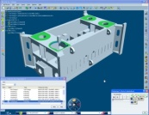


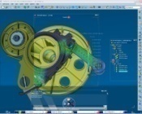




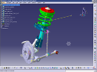

V6 Architecture: Optimized for Extended Enterprise & Supplier Collaboration - Examples
❶
❷
A
F
F
D
❸
❺
A
❹
D
F
F
A: ENOVIA Application Server (MCS)
D: Database Server
F: ENOVIA File Server (FCS)
❶
ENOVIA 3DLive Collaboration
Remote Access (with FCS)
PLM Exchanges via V6 Briefcase Solution
CATIA V5 Partner delivering in a V6 Project
3DXML Publishing
❷
Livecollaboration
Asynchronous collaboration
❸
❹
❺

Slide 62
Conclusion
You should now be able to:
Describe the ENOVIA V6 Architecture and its major components
Describe how ENOVIA V6 addresses remote user file access
Describe the secure infrastructure provided by ENOVIA V6
Describe how ENOVIA V6 addresses global collaboration

